Slide 1
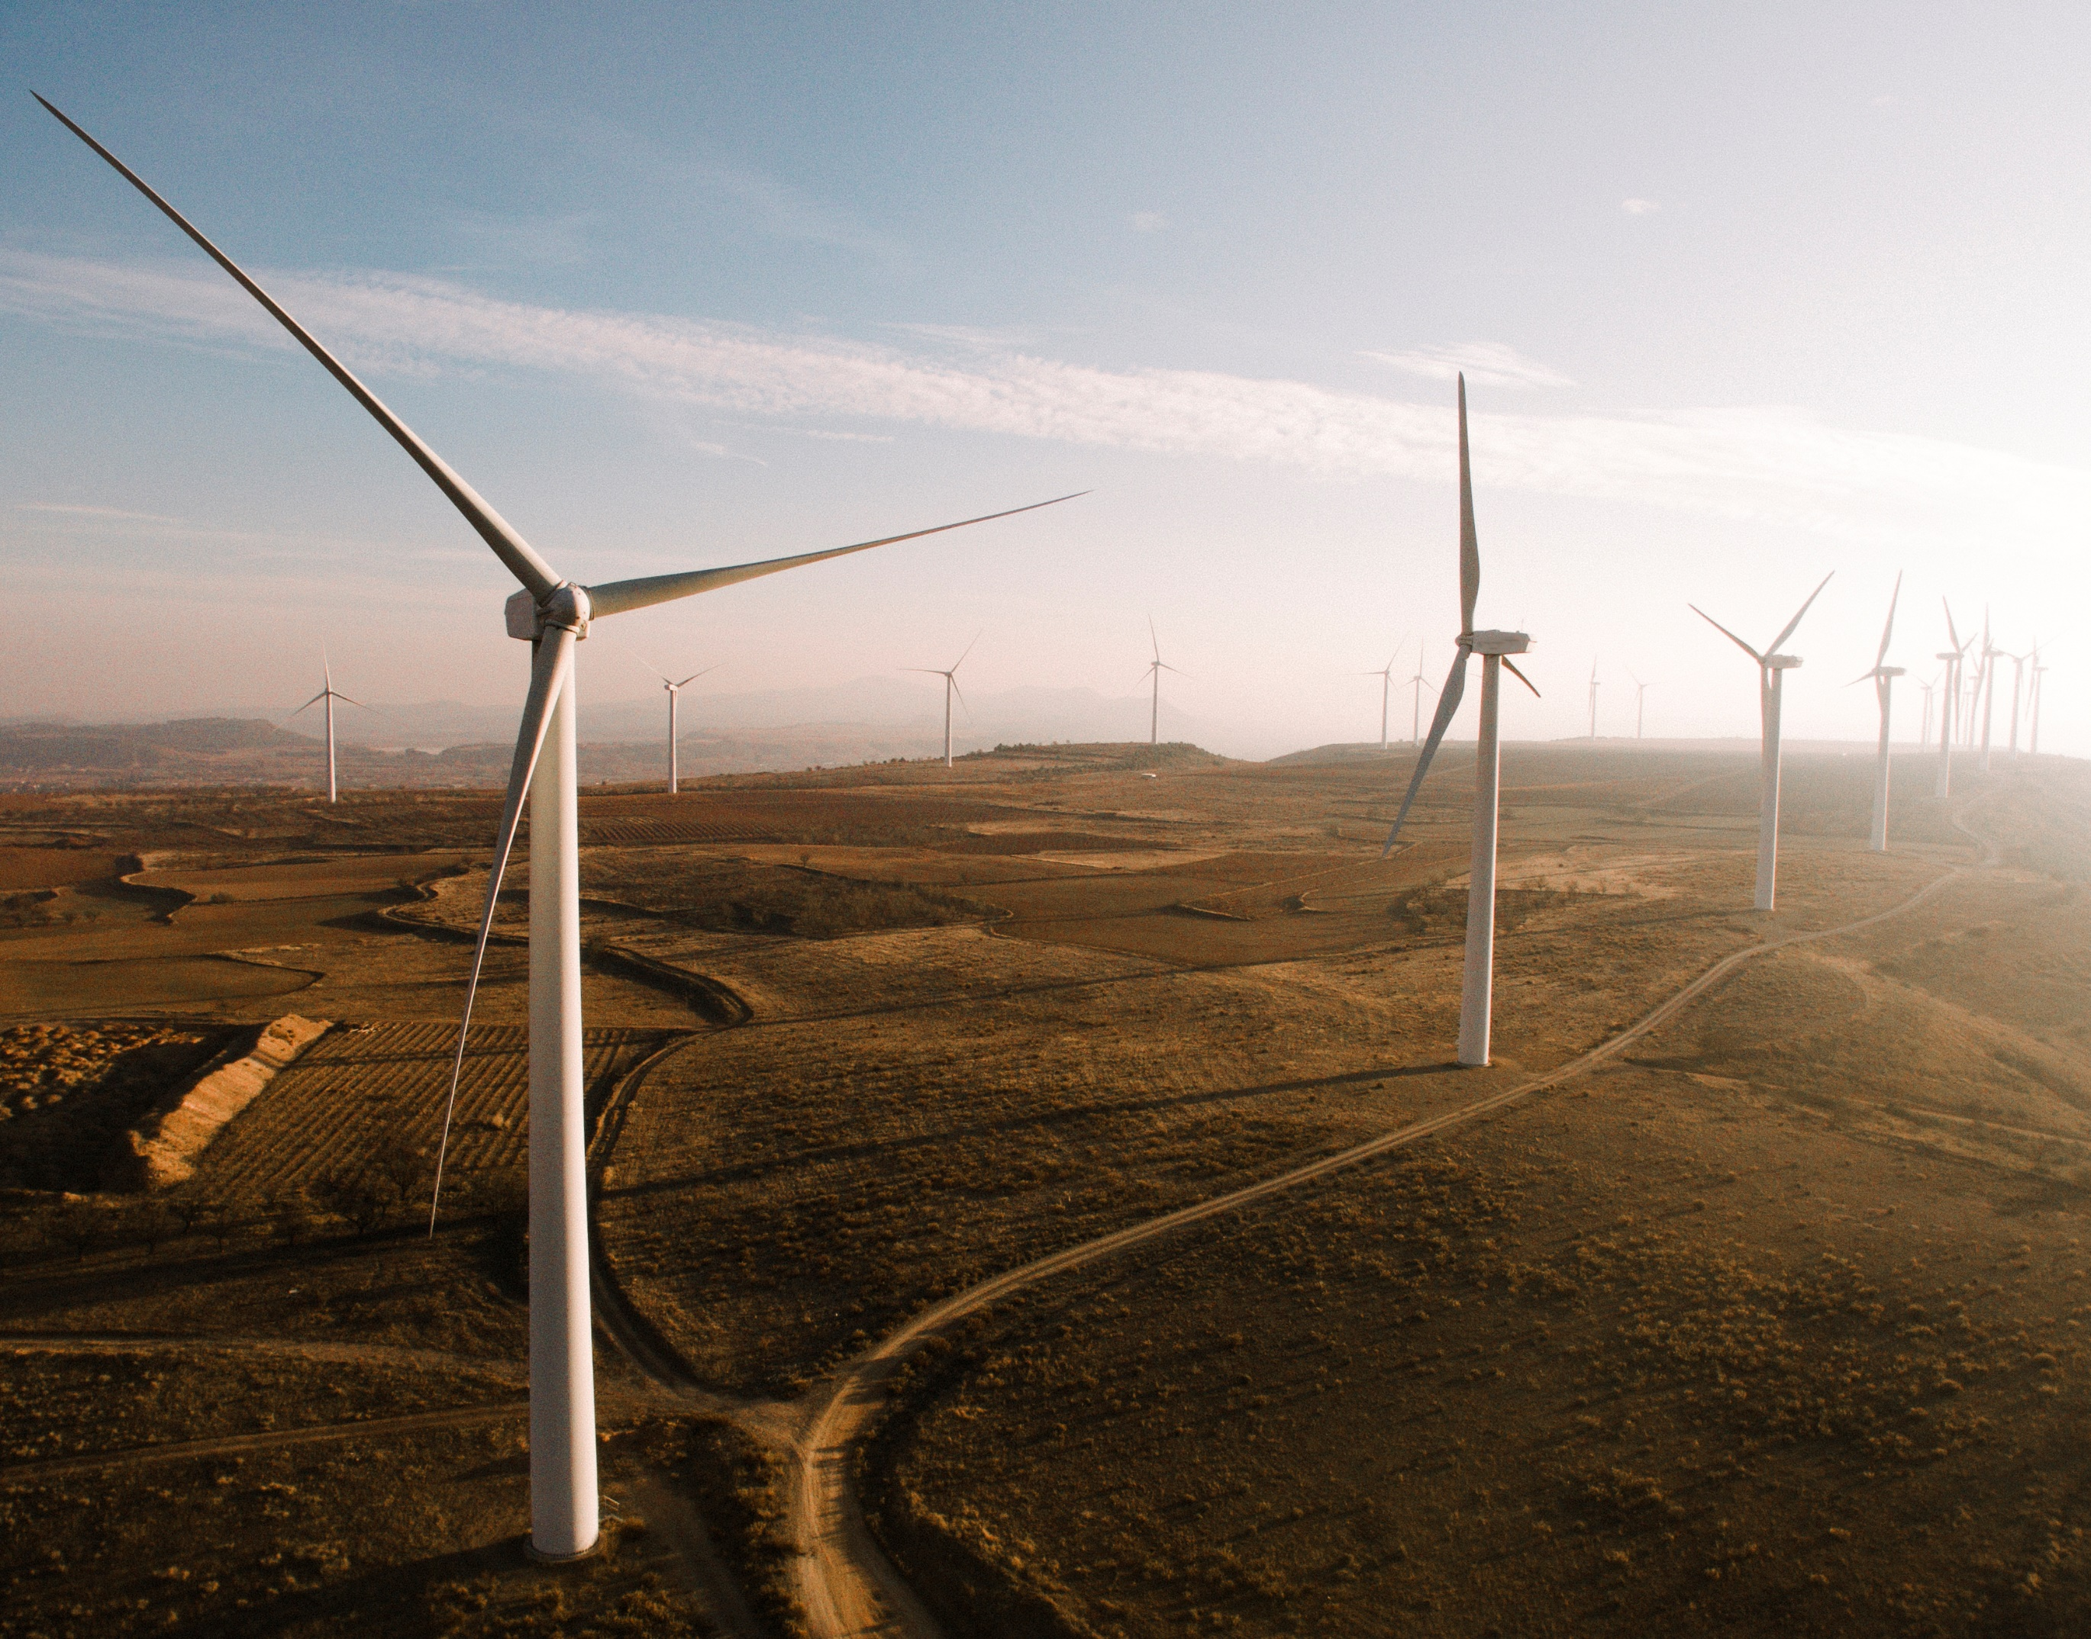




Clean UtilitiesTM in the Northern Territory
2022
Notes:
Hi,
My name is Chris Vella, co-founder of NTech for the Sugarcity.io team at Govhack 2022. We are excited to introduce our solution, Clean Utilities in the Northern Territory.

Slide 2





The Team – ‘Sugarcity.io’
Aiden Payne
Chris Vella
Dennis Murphy
Nathan Payne
Todd Turner
Full Stack Developer
What I Do:
Application Development
Full stack development
Solution Architect
Senior ICT Systems and Cybersecurity Engineer
What I Do:
Cloud Infrastructure
Solutions Architecture
Cybersecurity Engineering
Governance, Risk, and Compliance
Project Management
Electrical and Control Systems Engineer
What I Do:
Electrical Engineering
SCADA Development
Industrial control system programming
ICT Operations Manager
What I Do:
Cloud Specialist
Network Security Expert
Project Managent
IT Risk Management
Tech Enthusiast
What I Do:
Ex Power Systems Engineer
Cloud Engineer
DevOps
Notes:
The Sugarcity.io team consists of 5 members from Mackay, Queensland. These are Aiden Payne, Chris Vella, Dennis Murphy, Nathan Payne, and Todd Turner.

Slide 3

The Challenge
Displacing Diesel
How might we use data and technology to displace all diesel in the Territory?
The Territory is highly reliant on diesel for domestic, commercial and industrial use in remote areas. The high cost of diesel and risks in transporting to remote areas create significant opportunities.
Supporting Challenges
The following challenges have been identified to support and achieve the main challenge of Displacing Diesel in the Northern Territory
Integrate Disparate Data Sources like a Palantir Engineer
The 2021 Australian Census
Notes:
Together, we have looked to address the challenge of displacing diesel in the Northern Territory for domestic, commercial, and industrial uses in remote areas. Additionally, we have targeted the use of the 2021 Australian Census data, creatively used data in response to ESG, reach net zero emissions, and fused multiple data sources like a Palantir Engineer.

Slide 4

Overview
Our solution to displacing diesel in the Northern Territory is to create a connected IoT driven virtual power plant in each community using scalable green energy power generation solutions such as solar and wind, coupled with small scale housing-based energy storage devices.
Real-time usage metrics from community IoT sensors report to a central platform, along with available data from the Bureau of Meteorology and the Australian Bureau of Statistics we can then make data driven decisions of where these solutions are needed most or will have the biggest reduction in diesel consumption.
The platform is also able to monitor diesel consumption in real-time and predict optimal times for refuelling reducing the need for oversized or unneeded trips to remote locations such as Kaltukatjara.
Notes:
Introducing our solution, CleanUtilities. This is an IoT driven Virtual Power Plant (VPP) that unifies scalable and renewable energy generation solutions, such as a solar and wind, coupled with existing large-scale power production. The aim is to interconnect small house and business based generation and battery storage into a network that displaces the need for costly fossil fuel equipment.

Slide 5
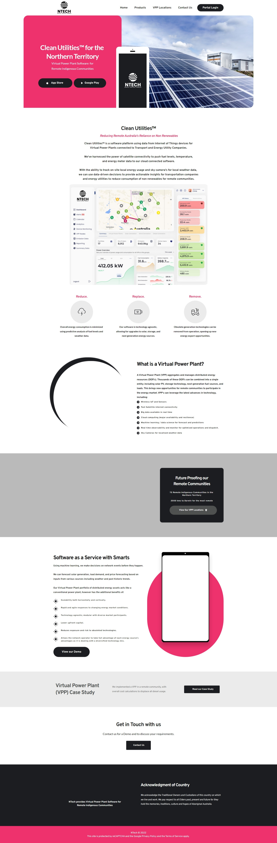
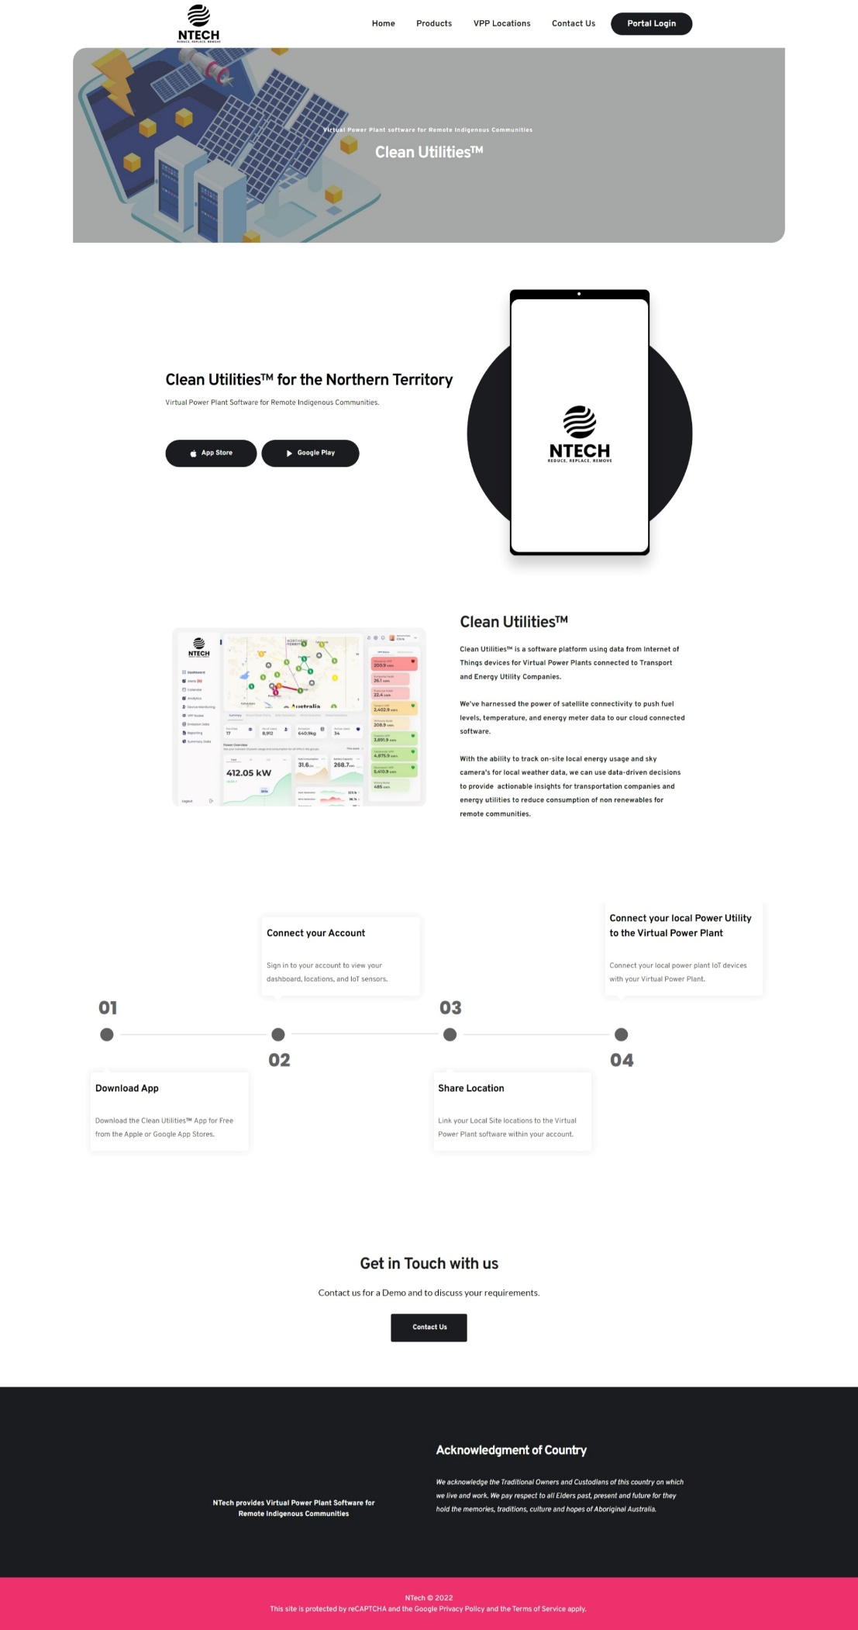
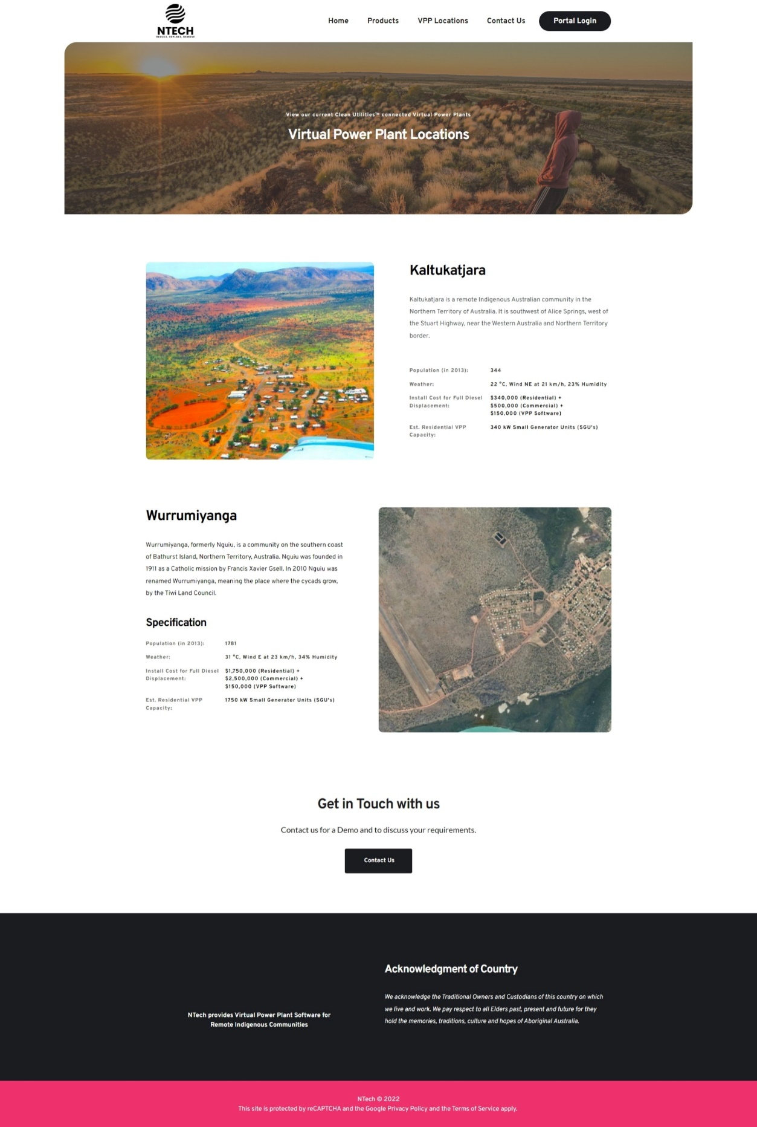
Overview
Notes:
While the concept of a Virtual Power Plant is not new, the introduction of our new technologies in IoT sensors and network communications, along with advanced software solutions, has dramatically altered the viability of displacing diesel in remote areas and shifting to clean energy in all communities. As displayed, we have developed a full website for the NTech business and CleanUtilities product set.

Slide 6
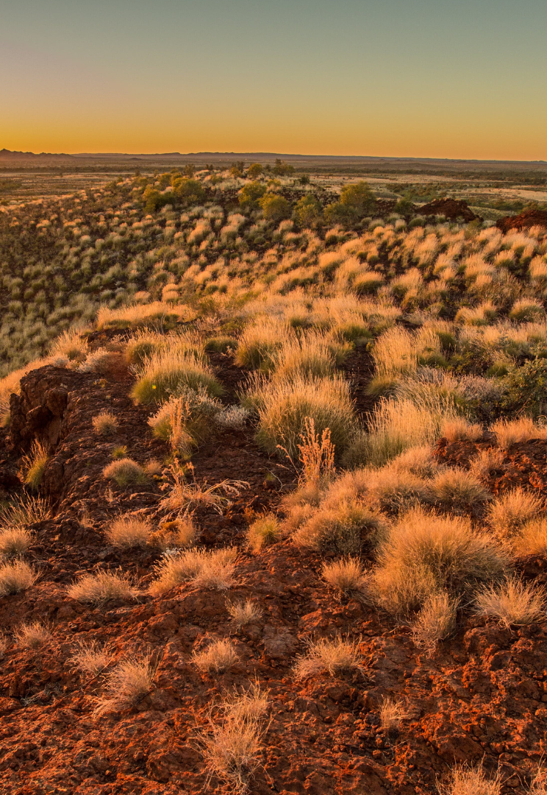
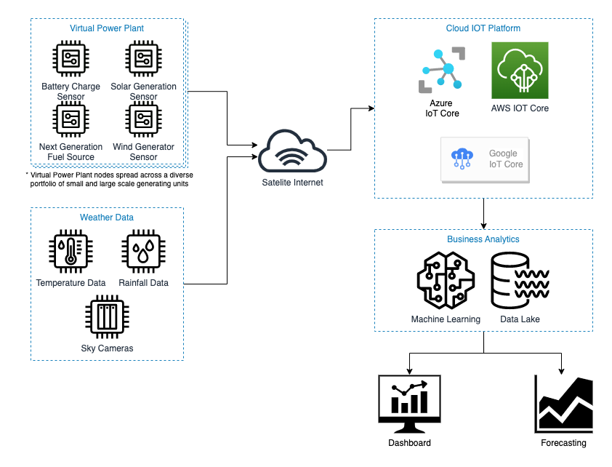
Hardware
Generating and storage of clean energy is paramount.
To predict, monitor and replace energy creation with green alternatives we will use an array of sensors such as:
Power Monitoring Sensors
Battery Sensors
Weather Sensors
Fuel Reserve Sensors
Solar Sensors
Sky Cameras
New advanced networks, such as Starlink satellites, LTE-M, and NB-IoT facilitate communications to our central systems and SaaS platform.
Notes:
Clean Utilities is powered by a multitude of IoT sensors, such as power monitoring, battery, weather, fuel reserve, solar and sky cameras. This technology has been effectively commoditised and the costs reduced to allow for the integration of sensors into a wide range of areas. Network communications have also improved in recent years with the introduction of advanced networking with Starlink satelittes, LTE-M, and NB-IoT, facilitating communications back to our central systems and SaaS platform from typically remote and disconnected areas

Slide 7
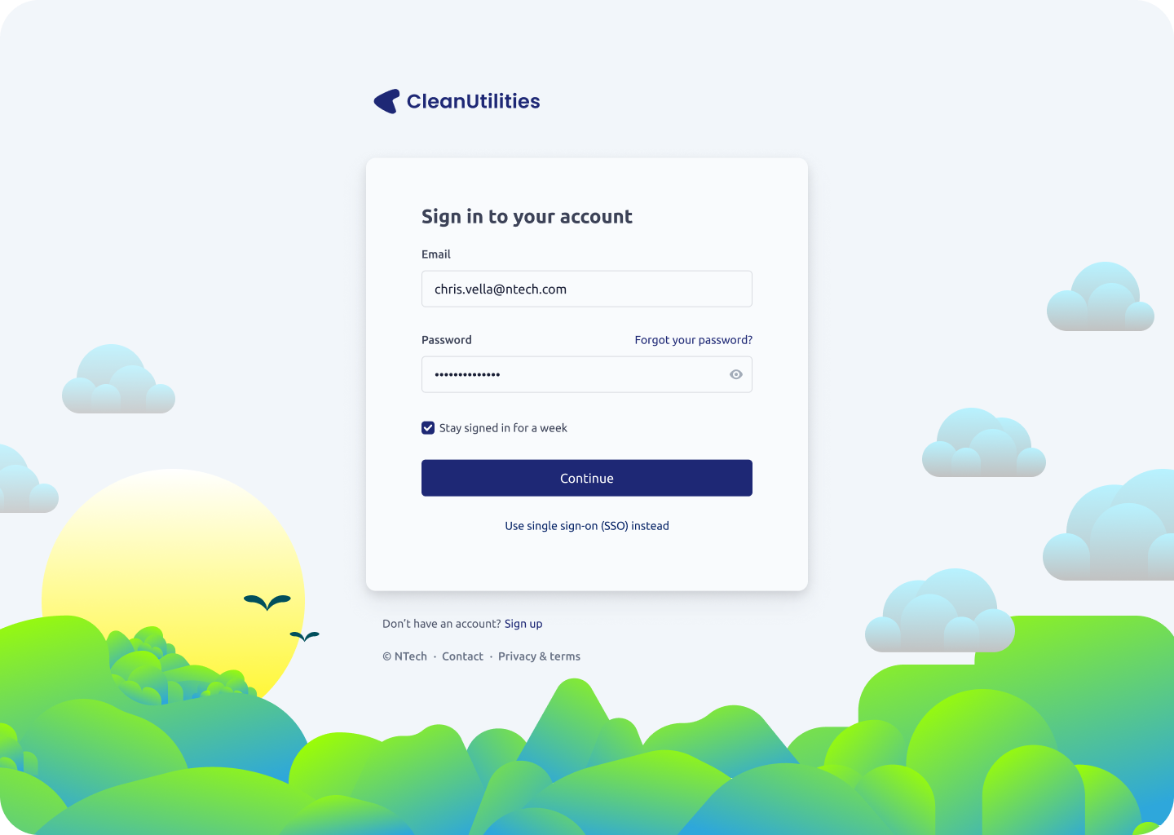
Software Platform
We have designed an enterprise SaaS-based web platform that allows residents and government organisations to view current power information for their house and even their community.
Notes:
The Clean Utilities platform is underpinned by our enterprise Software as a Service (SaaS) website that allows corporations, governments, and businesses to configure, deploy, and control their virtual power plant. This web application provides a anywhere, anytime accessibility.

Slide 8
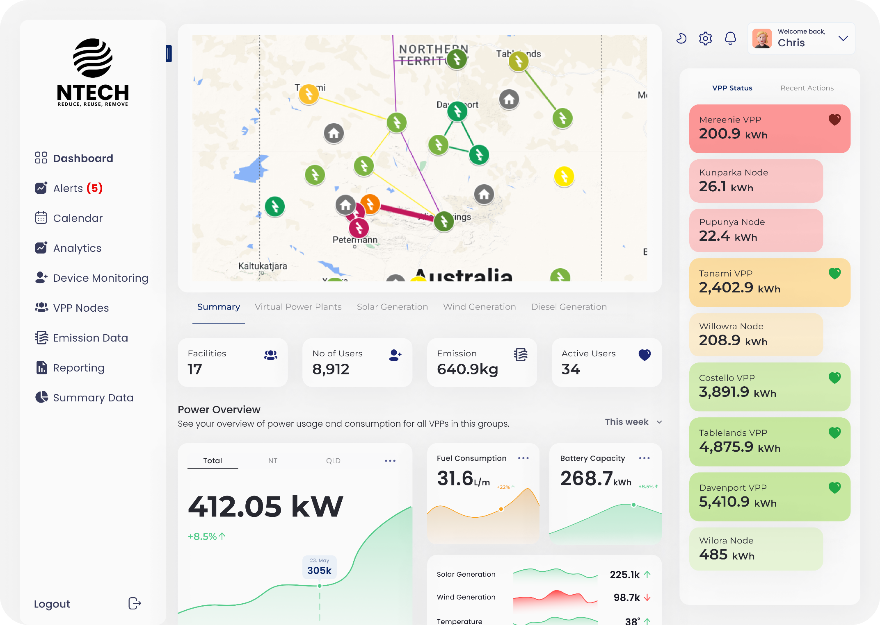
Software Platform
Using the data collected from our IoT sensor network, along with data from government sources such as the Bureau of Meteorology and the Australian Bureau of Statistics we have a clear single pane of glass platform for monitoring, maintaining, and predicting future needs and growth.
Notes:
Our initial focus was on displacing the diesel usage within the Northern Territory, and this is a demonstration of the Clean Utilities SaaS Platform. As demonstrated, we provide an intuitive interface that integrates the data from our IoT sensors and maps these into their virtual power plants. The platform provides key insights, device and VPP monitoring, predictive analytics, health and heartbeat status of devices and nodes, and much more across a single pane of glass.

Slide 9
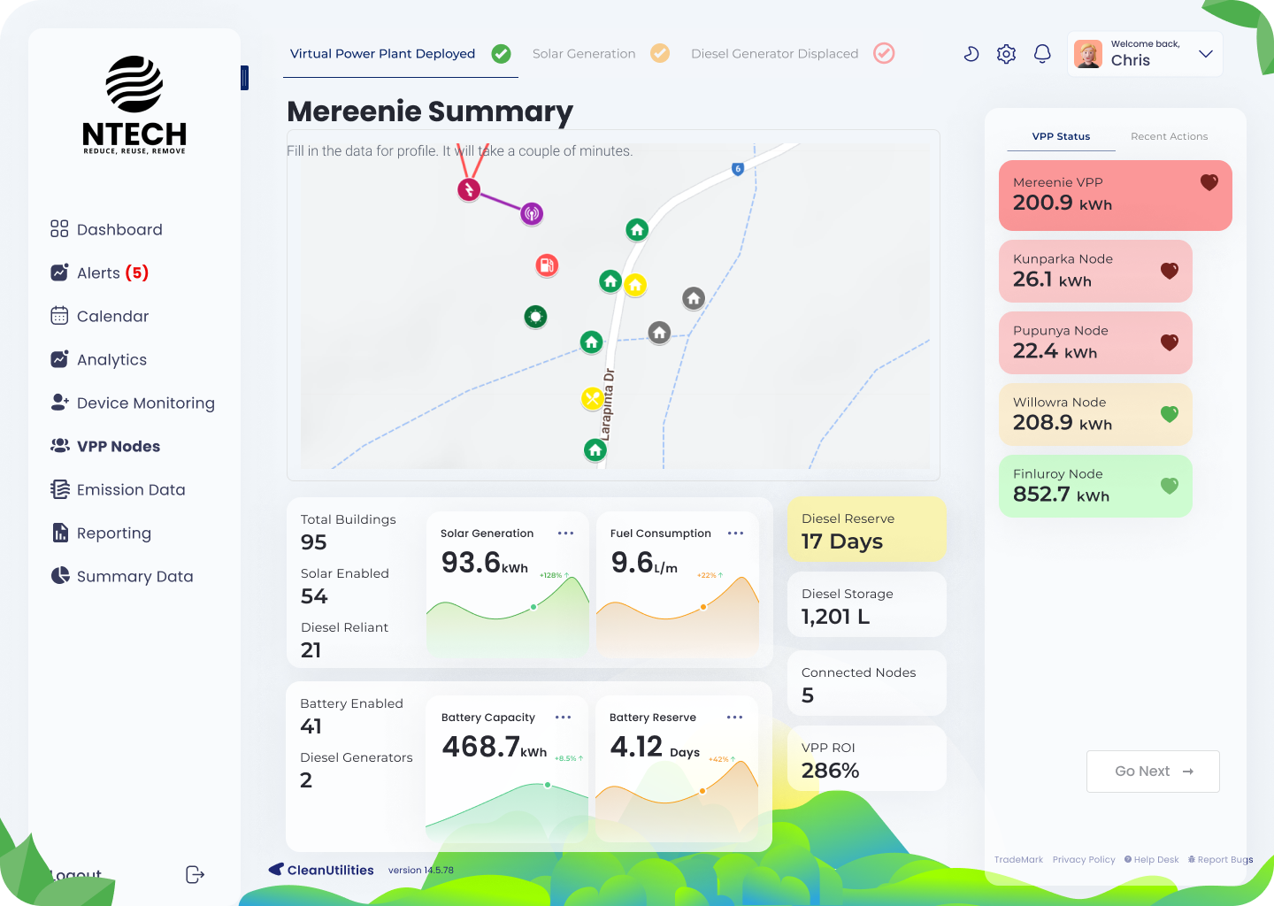
Software Platform
Residents and Communities alike can access the same SaaS platform and see how they compare to neighbours and other communities of similar sizes. Encouraging smarter responsible use of electricity.
Notes:
Greater detail is available for each node community, which can be made available to community leaders and members to gain insight into their transformation to clean energy use and the removal of fossil fuel power sources. The platform also provides for operational maintenance and oversight of power operations, power trends, and projections for required actions and changes.

Slide 10

Power
Cheap, clean power sources are critical to displacement of diesel in remote communities
Using a combination of renewable energy sources such as solar and wind we can displace consumption of diesel during daylight hours and periods of wind. These sources of energy can then be stored in battery systems to supply power at night etc.
Notes:
A report released by the Australian Renewable Energy Agency, documented that the Northern Territory's Power and Water Corporation previously ran a Diesel Displacement initiative, the NT SETup.
The NT SETup saw 10MW of Solar PV systems were installed across 25 sites between 2017 and 2018, with one of these sites also including battery storage.
This initiative, although successful in displacing diesel, could have been better as the Renewable Energy Factor achieved across the sites without battery storage was only 15%, due to the curtailment of the solar generation to ensure stability of the network during periods of volatile renewable output.
Virtual Power Plants, due to being distributed in nature, diverse in energy source and operating via realtime data and analytics, do away with the need to curtail the output of renewable energy sources; ensuring maximum Renewable Energy Factors are achieved at all times. The diverse nature of the Virtual Power Plants energy sources also ensures renewable energy is always present, even when the sun isn't shining.

Slide 11

Data Sources
To make data driven decisions the following data source have been used.
Bureau of Meteorology
Historical Weather Data
Current and future forecast data
Australian Bureau of Statistics
Population information past, present and future
Northern Territory Government
Population and water data for NT remote communities
Clean Energy Regulator
Postcode data for small-scale renewable energy installations
Notes:
We used a range of data sources, including:
Bureau of Meteorology
Historical Weather Data
Current and future forecast data
Australian Bureau of Statistics
Population information past, present and future
Northern Territory Government
Population and water data for NT remote communities
Clean Energy Regulator
Postcode data for small-scale renewable energy installations

Slide 12

Conclusion
NTech can provide Clean Utilities for the Northern Territory
Reduce Diesel Consumption
Replace power supply and generation with renewable sources
Remove reliance on Diesel
Notes:
We hope you are as excited by NTech CleanUtilities and the future of clean energy as we are. Thank you and have a good day.

